Slide 1
UP - File Sharing
Brogrammers

Slide 2
Objectives
To make file transfer between heterogeneous devices simple and fast.
File transfer - Images, PDFs, Audio and Video files, etc
Heterogeneous devices - Web app and Android app
Simple and fast - Minimal steps and optimizations

Slide 3

Use Case and Motivation

Slide 4
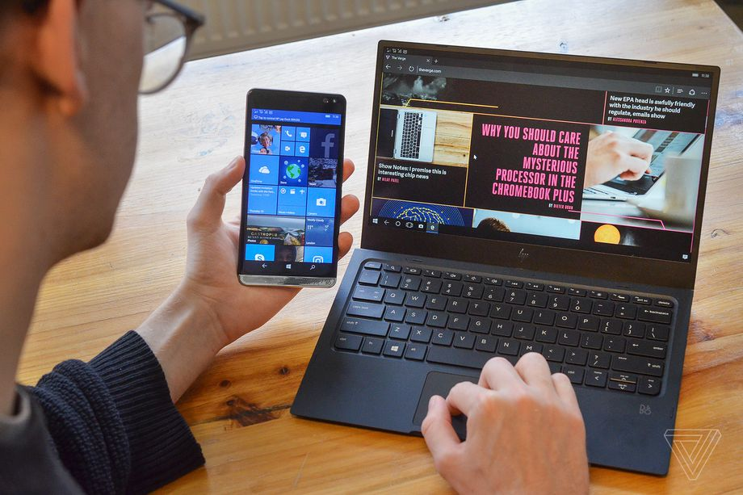
Use Case and Motivation

Slide 5
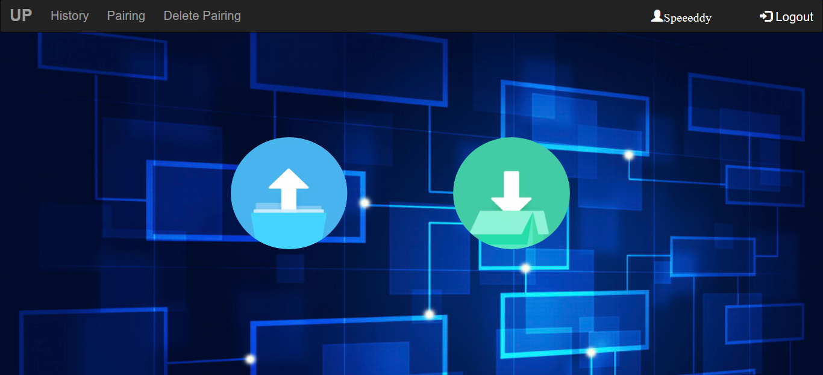
Up File Sharing

Slide 6
Non-functional Requirements Satisfied
Security - Using HTTPS and Encoding while storing
Performance - Optimized code and AWS’s boost
Portability - Independent of OS, browser, device
Availability - Server online 24/7
Usability - Ease of access through smooth UI
Correctness - steps against File corruption while transfer

Slide 7
Suggestions from Crowd Testing

Slide 8
01
Check for user existence
Resolved
02
Timestamp for actions
Resolved
03
Resolved
Redundant home button
04
Sort History by timestamp
Resolved

Slide 9
05
Resolved
Display details of Files - Timestamp, Size, Format
06
Send file to multiple users
Resolved
07
Resolved
Send multiple files to a user
08
Resolved
Pairing between for users

Slide 10
Project Architecture

Slide 11
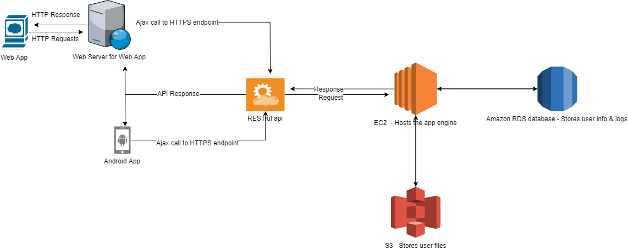

Slide 12
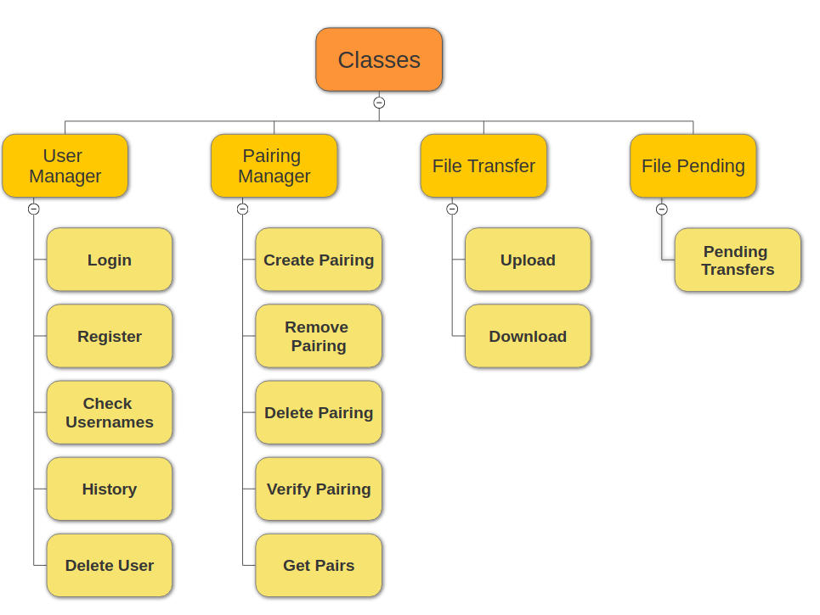
Logical Classification of REST API’s

Slide 13
Database & Testing

Slide 14
Database - After midsems
Database uses MySQL on the EC2 instance
User ( Name, Email, PhoneNumber, Username, Password )
Pairing ( Sender, Receiver )
FilePending ( Sender, Receiver, filename, filehash )
FileLog ( Sender, Receiver, Filename, FileSize,Filehash, Time, Action

Slide 15
Database - After midsems
Triggers to record Download and Upload logs
Used in History tab of the Web and Android apps
Can be used to view what files have been uploaded and downloaded by the user
Helper Functions to interact with Database
Form the database access layer - Interface between the REST APIs and Database
REST APIs need not connect to the database
APIs use the helper functions to perform database operations

Slide 16
Testing - After midsems
Testing using PyUnit in python3
New tests for server API and Database helper functions.
Positive and Negative tests
Tests can be found in Engine Folder of UP Github Repo

Slide 17
Server

Slide 18
Server
Both the REST API endpoint and Web Application are hosted on Amazon’s Electronic Cloud Compute (EC2) instance.
Setting up RESTful API environment
Defining security policy
Only SSH, HTTP, HTTPS traffic allowed into the server
Procuring and registering domain name up-karoon.ga
Implementing HTTPS encryption for secure communication
Setting up the MySQL database environment
Integration with web and mobile application

Slide 19
Mobile Application

Slide 20
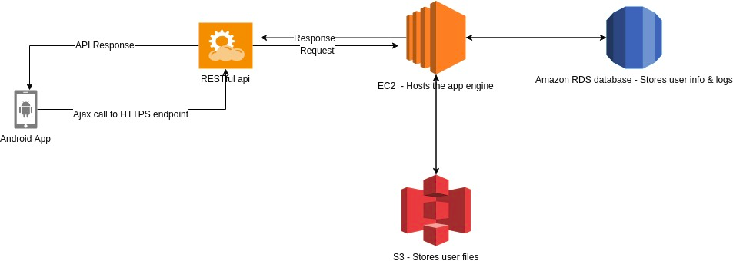
Mobile-Application
`

Slide 21



Mobile-Application: Back-end
Android Studio
Android Studio is the official integrated development environment for Google's Android operating system.

Slide 22
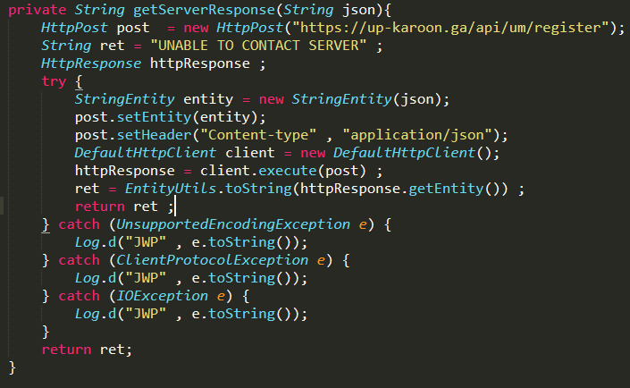
Mobile-Application
`

Slide 23

Mobile-App: Front-end
XML
JAVA

Slide 24
Web Application

Slide 25
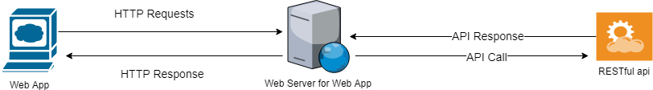
Web Application

Slide 26
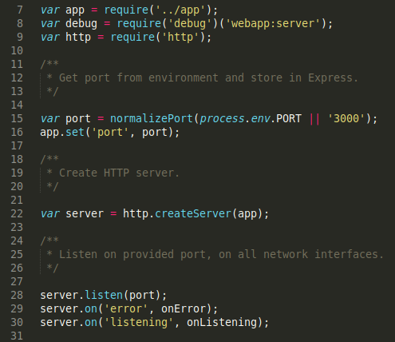
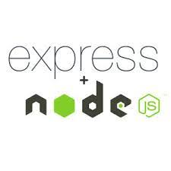
Web-App : Back-end
ExpressJS Server
Express.js, or simply Express, is a web application framework for Node.js, released as free and open-source software under the MIT License.

Slide 27

Web App - Front end
HTML
CSS
JavaScript
Bootstrap
jQuery

Slide 28
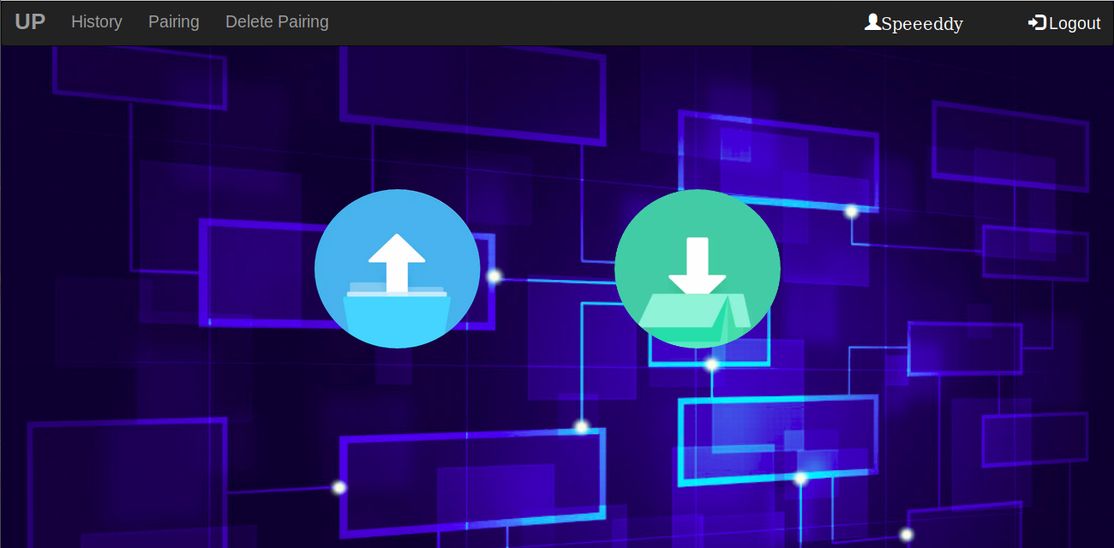
After Mid Sem

Slide 29
DEMO

